Slide 1
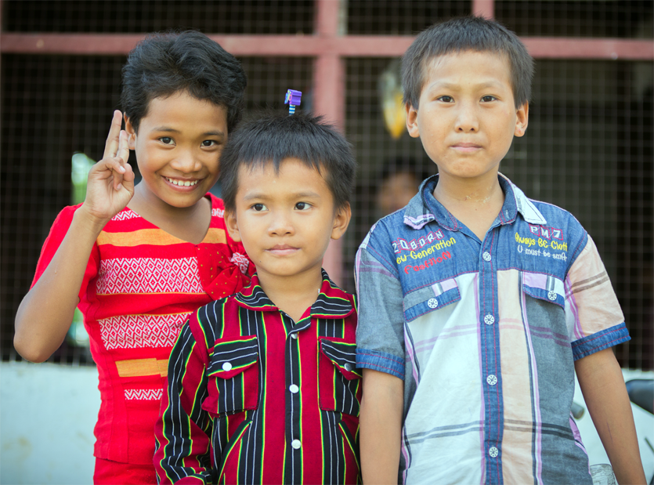
Notes:
Good evening! My name is Paul Keselman and I am the founder and President of the Mission2Myanmar. Before I start, I just wanted to say a very big thank you to Russell and Danny for giving me the opportunity to do this short presentation tonight. After having spent just over one week in Yangon with the Operation 513 group back in September 2017, I felt God was calling me to do so much more than hand out thousands of tracts to commuters. And so, I decided to start my own humanitarian charity in February 2018. The Mission2Myanmar is a humanitarian charity specialising in education and healthcare. My team and network of members, affiliates, and volunteers work very hard to make a difference in the lives of so many needy and distressed people living in Myanmar. I recently came back from a 3-week humanitarian mission trip to Myanmar in March this year but before I tell you about my travels, let’s go back to the Yangon campus in September 2017.

Slide 2
The Yangon campus back in September 2017
Notes:
Pastor David was forcibly evicted from his previous residence by an intolerant Buddhist landlord, he had nowhere to go with over 85 children and so, another Buddhist landlord sold him a rice paddy on his block of land. That rice paddy cost him everything he owned. He sacrificed his career and his assets to purchase a rice paddy. The drainage is very bad especially during the rainy season. Large stagnant puddles of water are still visible even after the heaviest rain has ended. You can see quite a few puddles right in the middle of the buildings. The children do their best to walk around the puddles because those puddles are notorious breeding grounds for water borne infections such as typhoid and cholera.

Slide 3
Why did Pastor David do it?
Raise a new generation of Christ-like children
Improve relations between Buddhists and Christians through better education and community development projects
Recruit and train a group of potential leaders
Create a sanctuary for unwanted children and orphans
Notes:
So you’re probably thinking; why did Pastor David do something like that. That’s a good question. Here are some reasons.
First BP – Christians are an ethic minority group in Myanmar which has suffered a lot of persecution in the past; most of which was orchestrated by the former Communist government. The previous government really did not like Christians and they managed to turn a lot of people against Christians for no good reason. Even though Myanmar is still a majority Buddhist country, most Buddhists were born into Buddhist families and they’ve never heard of Jesus. This is why Pastor David started a private college; because he wants to raise a new generation of Christ-like children.
BP2 – To restore friendly relations between Buddhists and Christians, better education is necessary and so too are community development projects like turning the mud track out the front of the driveway into a proper bitumen road. Both Buddhists and Christians need to use that road during rainy season but trucks and some cars will get bogged down if they use the mud track during the rainy season.
BP3 - Ps David is a very busy man and he often wears too many hats. Eventually he will need to have a group of trustful leaders to take over his various ministries.
BP4 – If truth be told, not every child that lives at the Yangon campus is a genuine orphan. Some of the children live with their aunties and uncles or with their grandparents during the summer holidays. Therefore, some of the children were abandoned by their parents.

Slide 4
Student demographics at the Yangon campus
Notes:
Pastor David currently has just over 100 children to educate and feed at the Yangon campus. This number is likely to increase to 125 children or even up to 150 children soon. Here are the demographics.
Around 10% of the children were abandoned by their parents and so, they stay at the Yangon campus for 9 months a year and then, they spend the summer break with their aunties & uncles or with their grandparents.
70% of the children at the Yangon campus have parents and those children were raised in remote towns and villages, very far away from Yangon. The trouble with the education system is that the new democratically elected Government requires that school children go to school for 4 hours a day which equates to about 3 and a half hours of education after you subtract the breaks. This shortfall in education is a major concern for both Buddhist and Christian parents alike. And that’s why those parents have decided to send their children to Pastor David’s private college.
David said and I quote: “All are from outside of Yangon coming from destitute and difficult country side where there are no electricity, no proper road, no hospitals or clinic, no stationery, no proper educational classes and many more. Yangon is a heavenly place for almost all of them and getting educational opportunities here in Yangon is a rare kind of golden opportunities and therefore many kids are waiting for an opportunity to get a chance to be with us in Yangon Centre.” End quote.
The rest of the children are orphan kids because they have no parents and there is nobody else to look after them.

Slide 5
So what did M2M do about it?
Raised funds to help Pastor David complete the construction of a double storey multi-purpose hall
Paid for another diesel generator to make enough power for the new multi-purpose hall
Paid for a water purification system so that the children could have access to safe drinking water
Raised funds to enable Pastor David to buy an adjacent block of land outright, without a mortgage
Notes:
Mission2Myanmar is a bit of a mouthful for some. In Australia we like to keep everything simple. This is why I often use the abbreviation M2M.
We registered with the ACNC back in February 2018 and in less than 9 months by God’s gracious provision, we achieved so much. Here is just a short list.
READ THE BULLET POINTS OUT LOUD
BP1 – Most people just call it the “new building”. It’s being used as a private school by day and as an orphanage shelter by night and that’s why we call it the multi-purpose hall.
BP2 – Ps David has 3 diesel generators and normally he switches them on at night. My Burmese brother and translator, Kennedy, is one of the caretakers and he lives at the Yangon campus. Kennedy told me that when all 3 are rattling in unison, it sounds like a freight train! Very noisy but it works. The Yangon campus will be connected to the Myanmar Government’s electricity grid any day now. I’m sure that Kennedy will get a good night’s rest when that happens.
BP3 – The water purification system is in the existing kitchen.
BP4 – Pastor David’s Buddhist landlord agreed to sell David a large block of land. By God’s grace, we raised enough money to buy it outright.
Let’s have a look at some pictures.

Slide 6
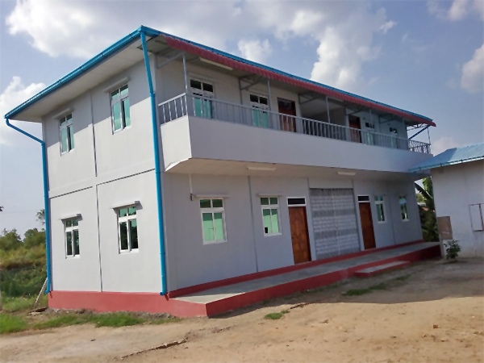
Multi-purpose Building
Notes:
This is it! This is the multi-purpose hall.

Slide 7
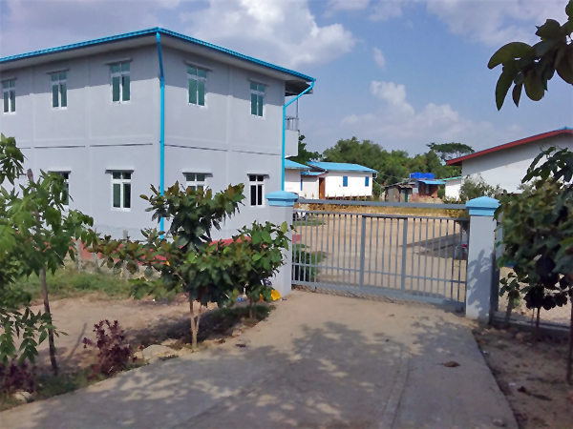
Security Gate
Notes:
To stop drunks and other intruders from getting in especially during the night.

Slide 8
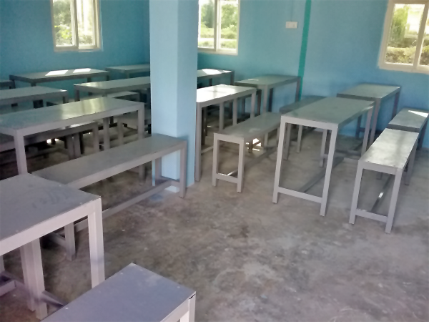
Desks and Benches
Notes:
The furniture is not very comfortable but that’s beside the point. The children are here to learn not to relax. All the furniture was assembled inside the new building. Pastor David paid local tradespeople to do this.

Slide 9
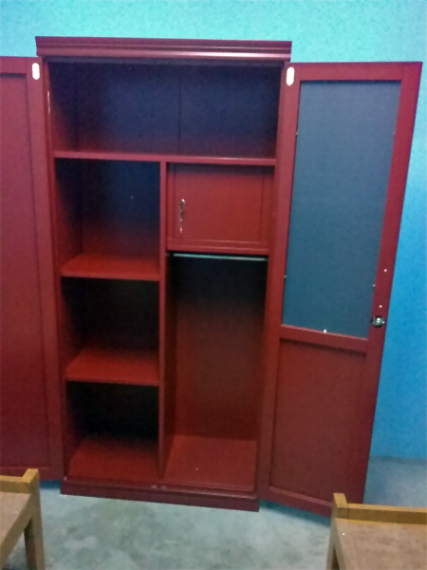
Caretaker’s Cupboards
Notes:
It’s not real mahogany. It’s just the finish.

Slide 10
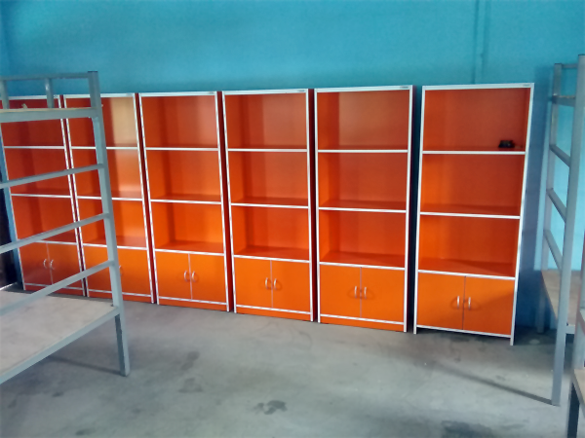
Bunk Beds and Student’s Cupboards
Notes:
Orange cupboards with light blue painted walls is a very good colour combination for studying. The cupboards and the bunk beds were also manufactured using raw materials on site.

Slide 11
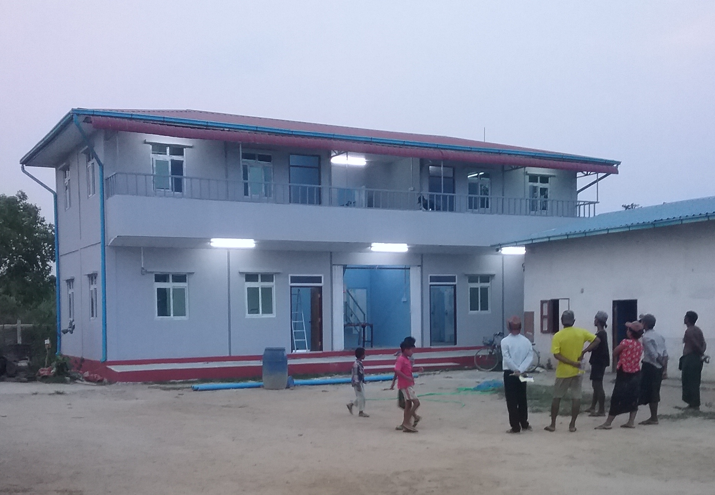
Reliable
Power
Notes:
Provided that the diesel generators are working, there will be light.

Slide 12
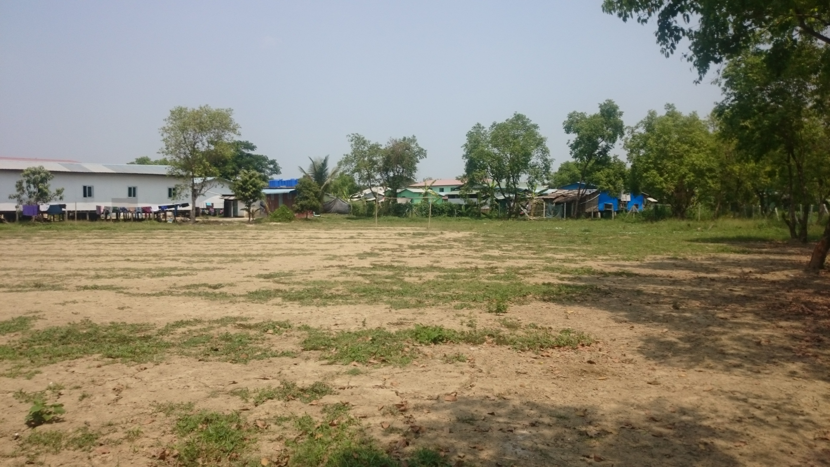
Land Expansion
Notes:
The new block of land will be used for more building projects such as the new kitchen building and it will also be used for cultivation as well.

Slide 13
What about the kitchen?
It was more prudent to put up the multi-purpose building back then
The kitchen was put on hold because we did not have the funds at the time to do both projects
Notes:
READ THE BULLET POINTS
Now I’d like to show you some photos from the existing kitchen which I took during my most recent trip to Myanmar in March this year.

Slide 14
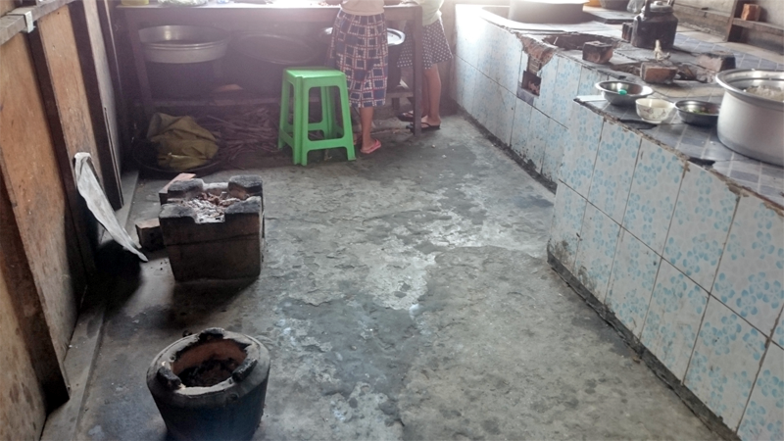
Dirty Floors
Notes:
Apparently, food preparation and cooking is something that you do on the floor in Myanmar, quite literally. There are many outdoor markets in Yangon and in other parts of Myanmar where everything is done on the ground.
When I realised that this is a cultural difference, I was hesitant to suggest a new Western-style kitchen where people cook and prepare food whilst standing. But Pastor David assured me that Elizabeth would be delighted to stand up in a Western-style kitchen. Who could blame her?

Slide 15
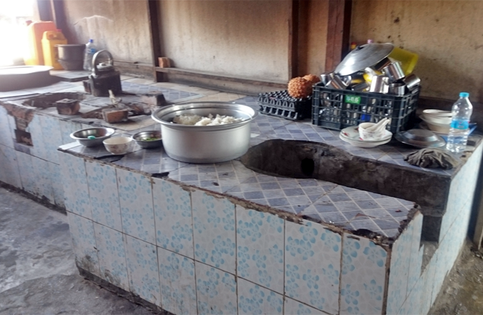
Damaged Kitchen Benchtop
Notes:
I don’t think telling Elizabeth to stand up and do the cooking and the food preparation using this damaged kitchen benchtop is the answer to the problem.

Slide 16
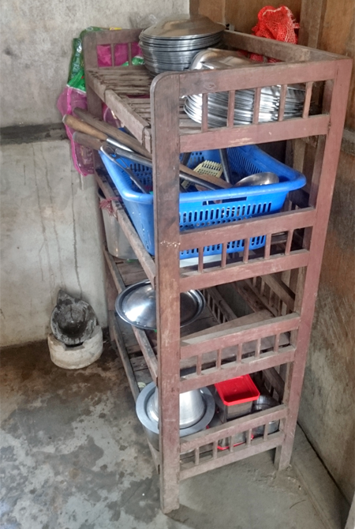
Unprotected Storage Shelf for Kitchen Utensils and Food
Notes:
This unprotected wooden shelf makes it very easy for pests and vermin to access food and kitchen utensils.
The diesel generators are normally switched on at night and that’s why the Yangon campus does not have any fridges. We are hopeful and prayerful that this situation will change after the Yangon campus is connected to the electricity grid.

Slide 17
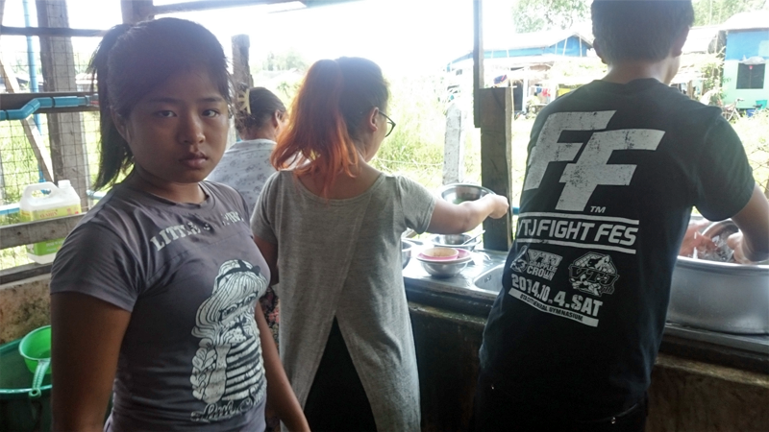
Washing
Dishes
Notes:
Washing dishes manually is a bit overrated but it has to be done. During the school year, this kitchen can serve anywhere between 100 to 150 meals, up to 3 times a day. That’s a lot of washing that will require a large volume of water.

Slide 18
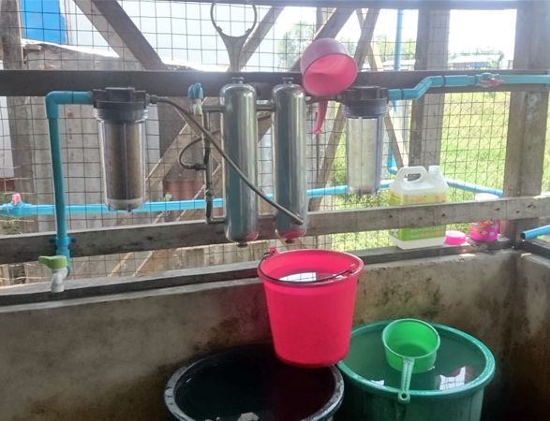
Water
Purification
System
Notes:
The water purification system is connected to the rain water tank and the purified water is stored in buckets.

Slide 19
Should we fix or replace the kitchen?
Fixing the kitchen is urgent because it can have a detrimental impact on the children’s health
Replacing the existing kitchen with a new building will be necessary because the existing kitchen is:
Too small to cater for 150 people times 3 meals per day
Causing damage to Elizabeth’s back because she has to prepare and cook the food on the floor
Notes:
BP1 – It’s a major health risk
BP2 – The adjacent dining hall is barely large enough to accommodate 100 people at a time. There is no insulation against the blistering heat. I could not eat there in March because it was too hot for me.

Slide 20
Tackle Poverty
and
Improve Welfare
Notes:
This is our slogan. The team at the Mission2Myanmar works very hard to alleviate poverty and improve the welfare of so many needy and distressed people living in Myanmar.

Slide 21
Questions
and
Answers
Notes:
I’ve probably gone overtime. As usual. But I’m sure that we have some time left for a couple of quick questions.

Slide 22
www.mission2myanmar.org
info@mission2myanmar.org
Notes:
If you need more information, please visit our website or write to info@mission2myanmar.org

